Slide 1
Beginning React

Slide 2
Chapter 9:
C.R.U.D With FireBase
Brief Summary Of Chapter 9
What is Firebase
Using Firebase
Adding Firebase to our React Project
Working with a Firebase Database
Displaying List Of Users

Slide 3
What is Firebase?
Firebase is Google's real-time database that offers a powerful backend platform for building fast and scalable apps without needing to write server-side code or manage relational databases. Using a NoSQL structure, Firebase stores data as a tree of JSON objects, increasing productivity by eliminating the need for complex table schemas. It also provides automatic, real-time updates, ensuring all connected clients see changes instantly without refreshing the page.
A NoSQL database uses flexible JSON structures instead of tables, making it easier to manage. However, for complex queries and reporting, a relational database may be better. Firebase eliminates the need for traditional RESTful services, offering seamless integration with React, especially in handling data and state management. Additionally, Firebase provides a variety of services like Authentication, cloud messaging, hosting, and analytics, with flexible pricing options, making it a versatile choice for developers.

Slide 4
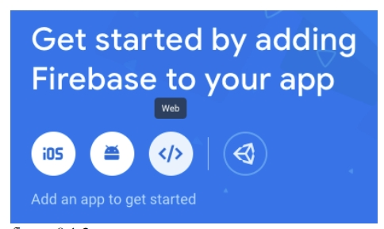
Using Firbase
Create a Firebase Account Firebase console (google.com)
Click on Create Your Project
When you get to this page "Get started by adding Firebase to your app"
Notice there are 4 icons, Click on the third one which looks like (</>)
Clicking the icon directs you to a page to create a nickname for your app.
Figure 1(next slide).

Slide 5
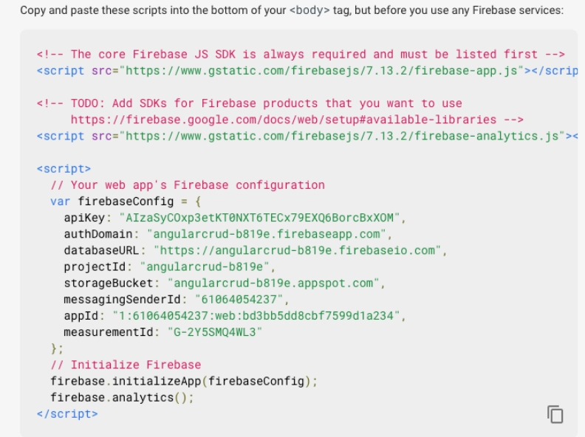
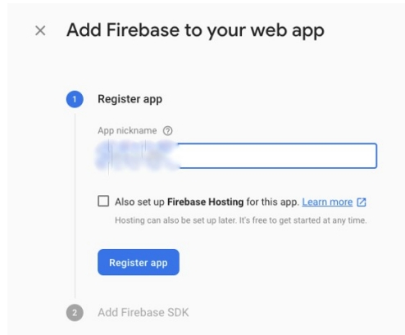
Figure 1
Leave the checkbox Unchecked
After you register code in Figure 2 will be displayed
Figure 2

Slide 6
Adding Firebase to our React Project
After npx create-react-app reactcrud and npm install firebase --save
The code in bold should be replaced with your own properties from the firebase.
Code for importing firebase:
import firebase from 'firebase/compat/app';
import 'firebase/compat/database';
import 'firebase/compat/auth';
compat is the compatibility layer in Firebase that allows you to use the older namespaced API with the newer SDK.
The auth service in Firebase provides user authentication and management capabilities for your application, handling user sign-up and sign-in while supporting various authentication methods.
The database service in Firebase provides access to the Realtime Database.

Slide 7
Working with a Firebase Database
Within your firebase account, Open Your project
Within the Build Section open Realtime Database
Create Database and select test mode
Difference Between Realtime Database and Firestore:
Realtime Database is a Firebase service that stores and synchronizes data in real time across all connected clients.
Firestore (also known as Cloud Firestore) is a flexible, scalable, and real-time NoSQL database provided by Firebase. It is designed to handle large amounts of data and provide real-time synchronization across multiple clients.

Slide 8
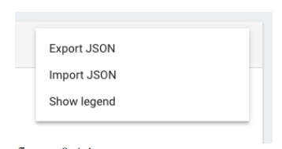
Displaying List Of Users
Getting your users here: jsonplaceholder.typicode.com/users
Add all users into a new file called users.json
Add users within realtime database using import json

Slide 9
Notes:
When creating your UserForm.js file replace this code:
}).then(() =>this.props.history.push("/"));
With this one: }).then(() => {window.location.href = "/"; });
When you get to 9.8 Updating a User replace this code:
export default UserForm;
With this one:
export default (props) => (
< UserForm {...props}
params={useParams()}
/>
);

Slide 10
End Of Chapter 9

